Slide 1
MAC
Make a cocktail
A website project of Gabriel Guerin, Saad Lamdouar and Olivier Burgaud

Slide 2
Goal
Functionalities
Find cocktail with alcoholic beverages
Users put in input the beverages and Make a Cocktail suggests a recipe
Create cocktails
Share recipes
Consult recipes
Vote for favourite cocktails

Slide 3
Target users
People w/ and w/o knowledge about cocktail making (for the sharing and finding functionalities)
Night clubs, bars, restaurants
Companies for special events

Slide 4
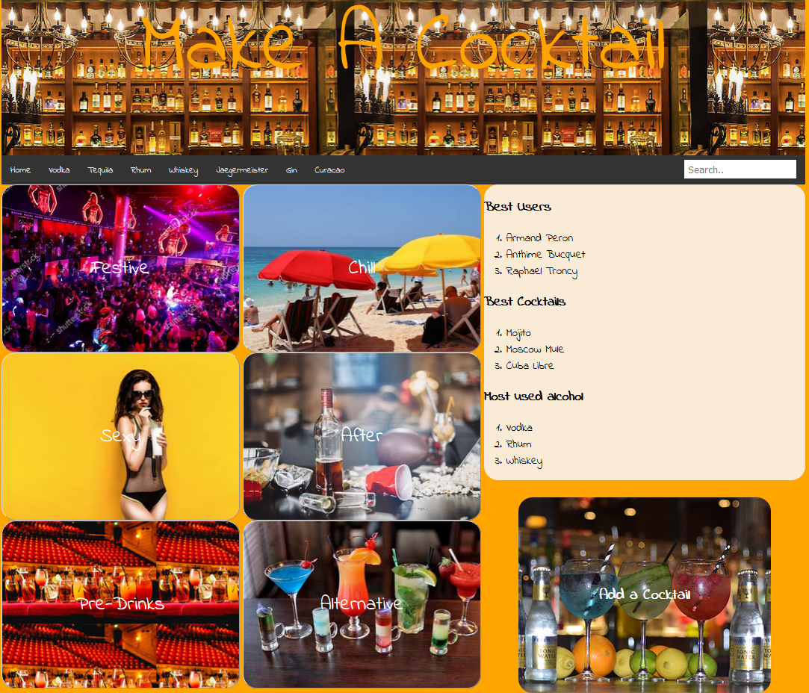
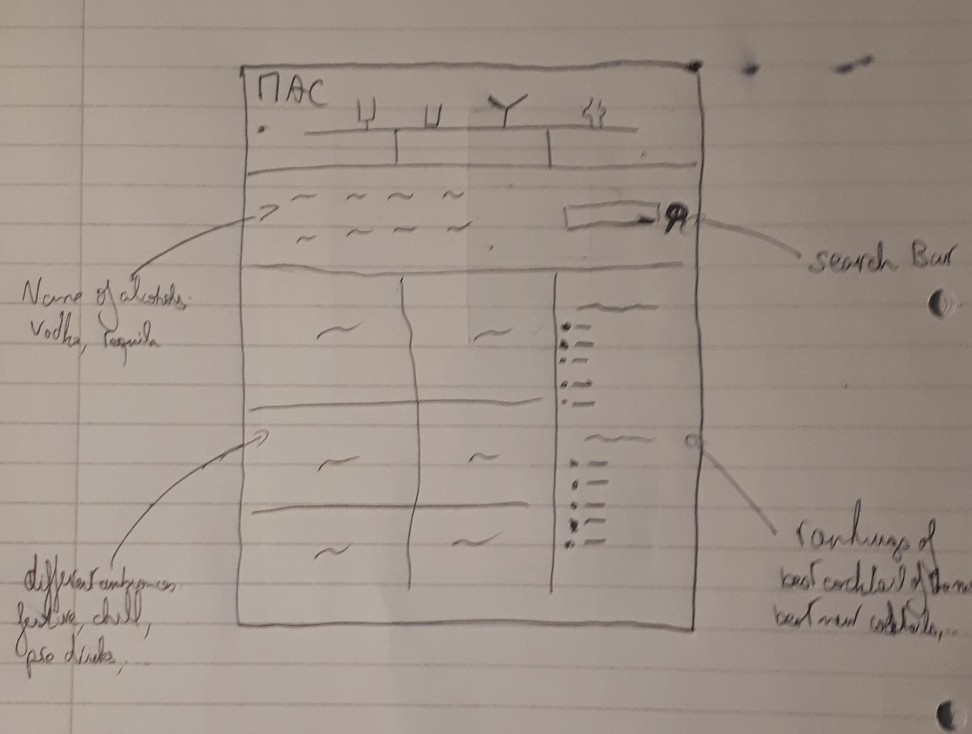
Sketches

Slide 5
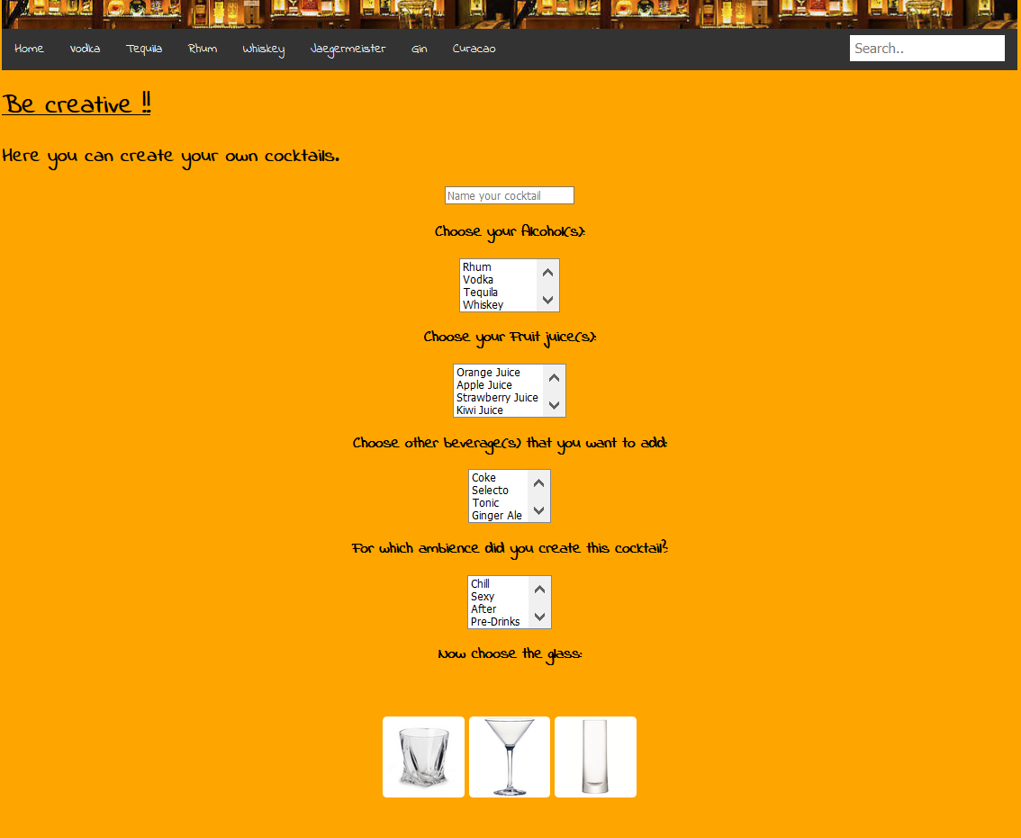
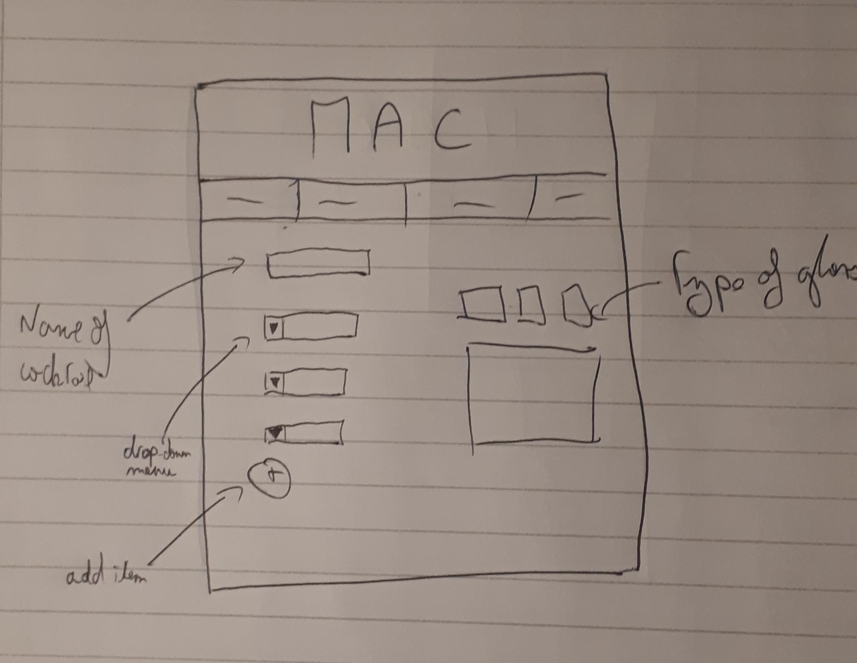
Sketches

Slide 6
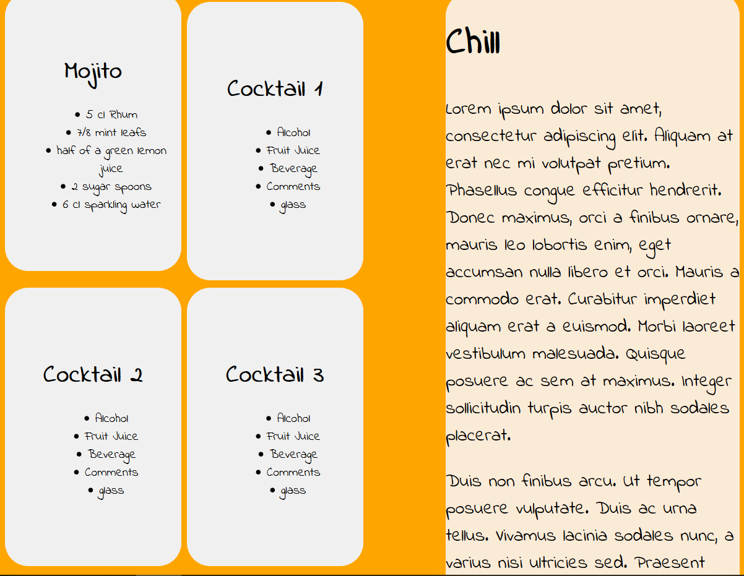
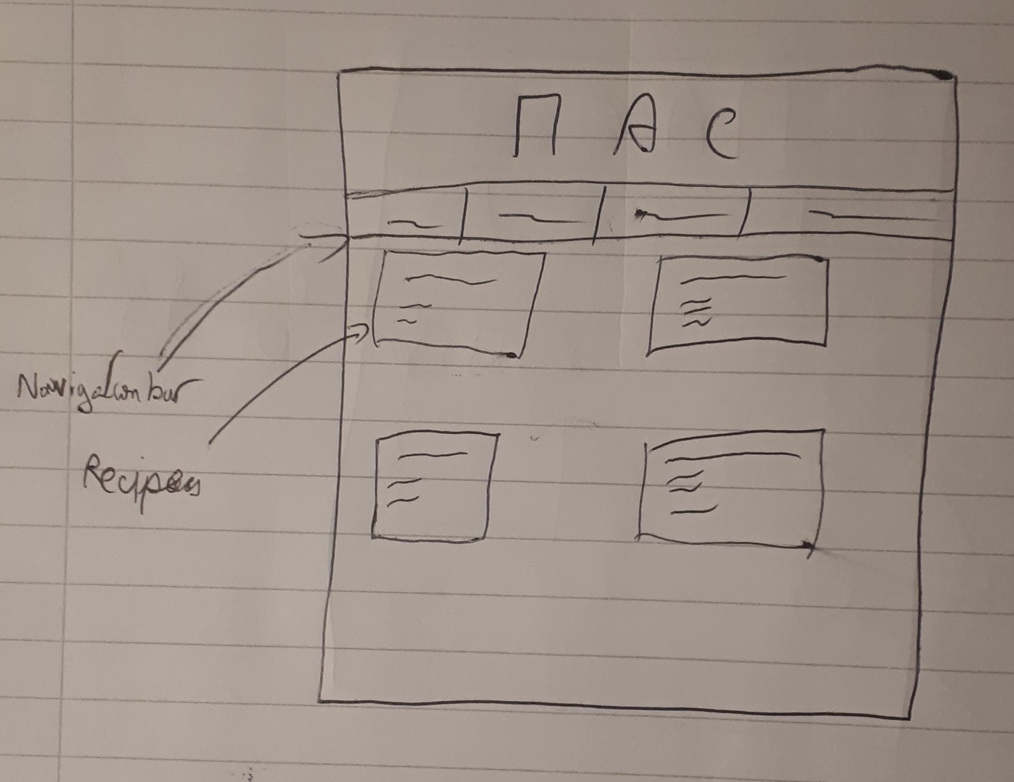
Sketches

